Slide 1


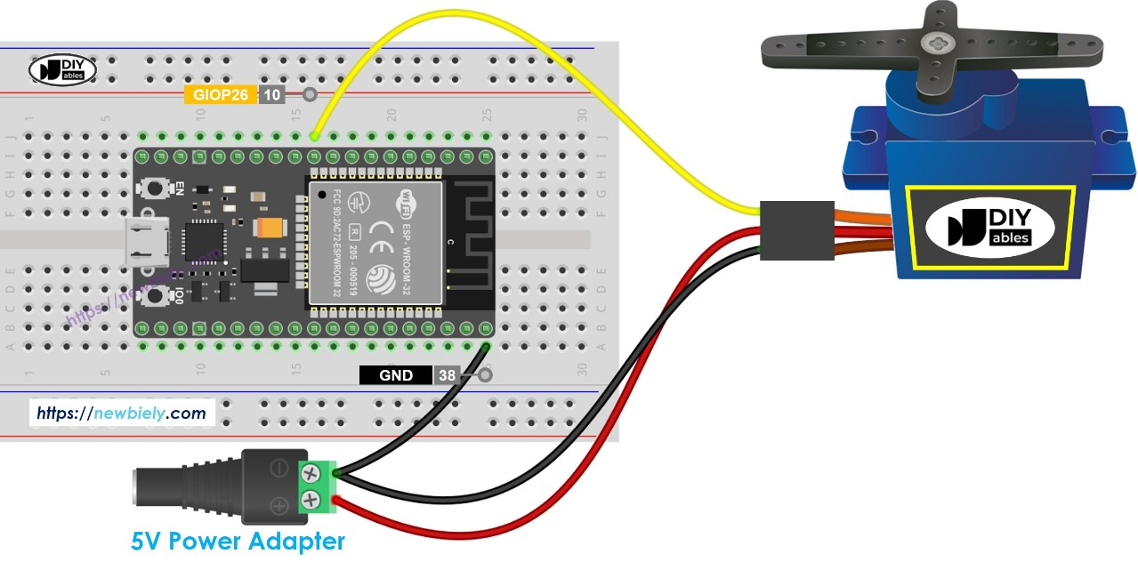
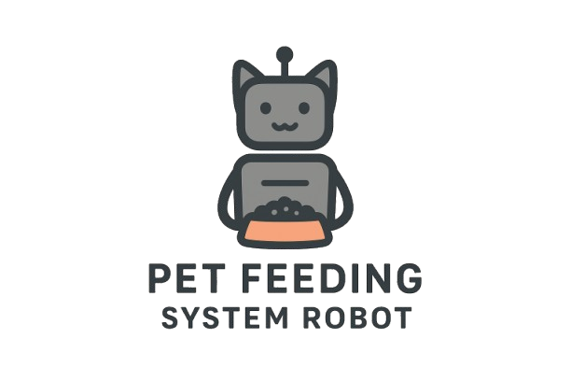
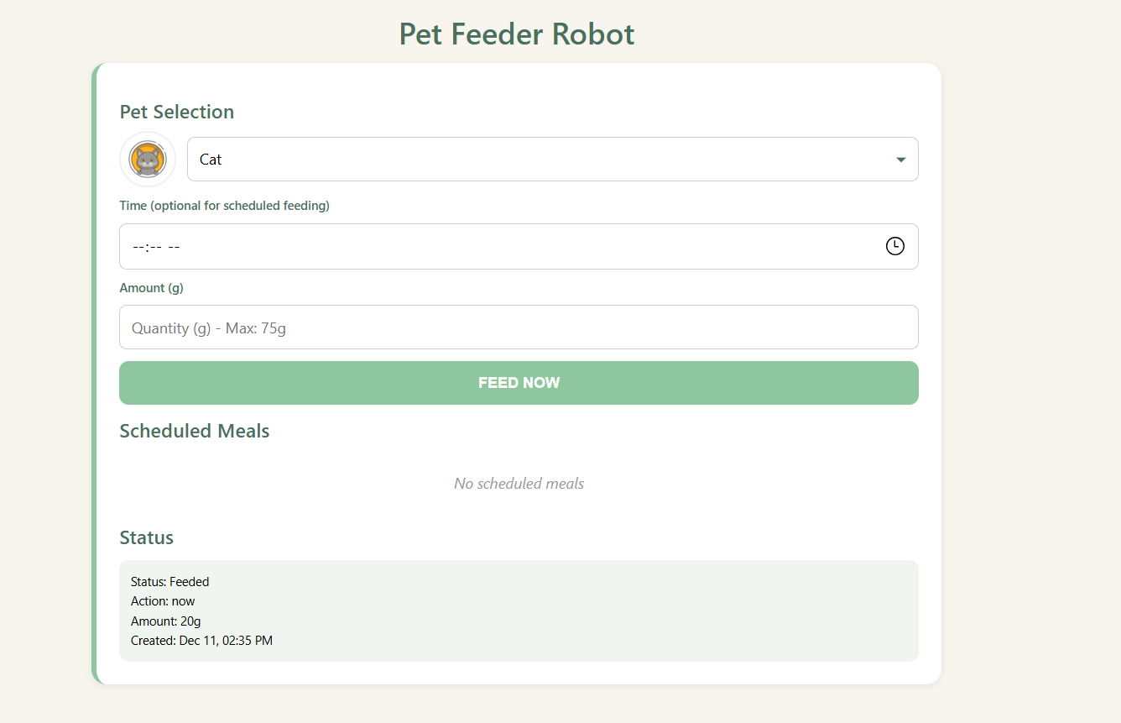
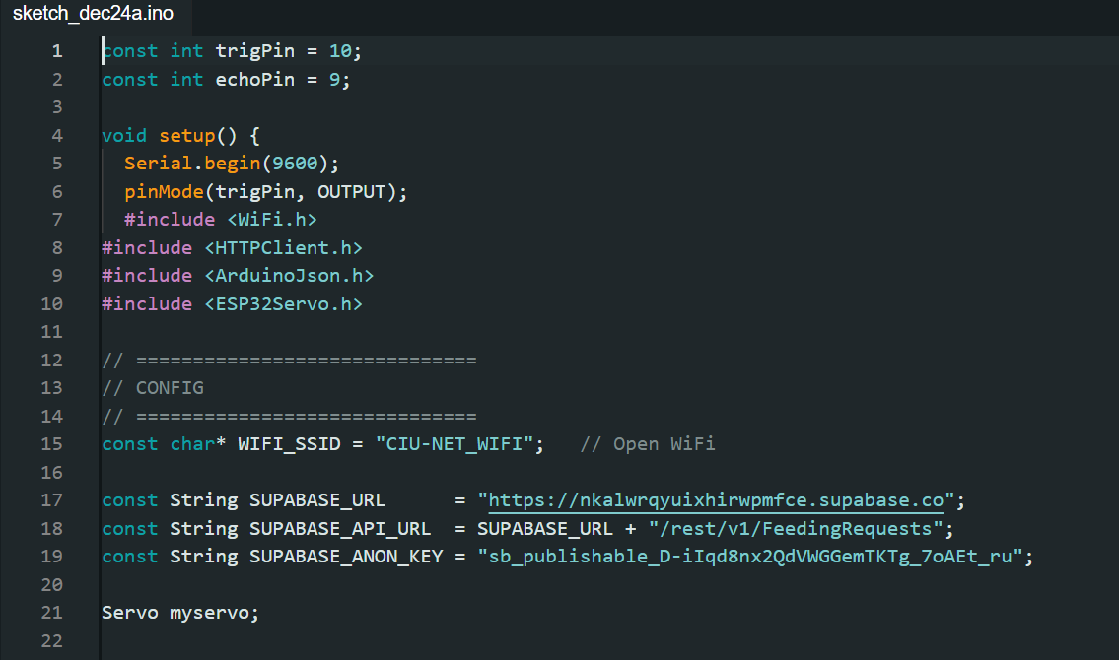
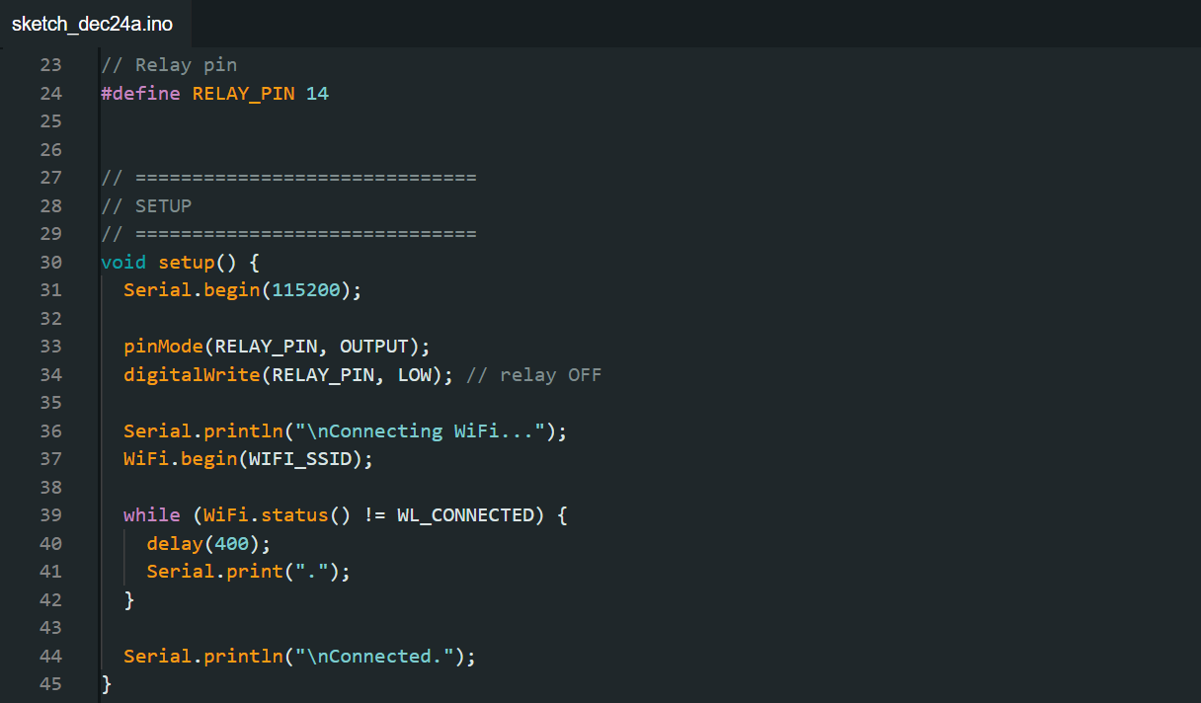
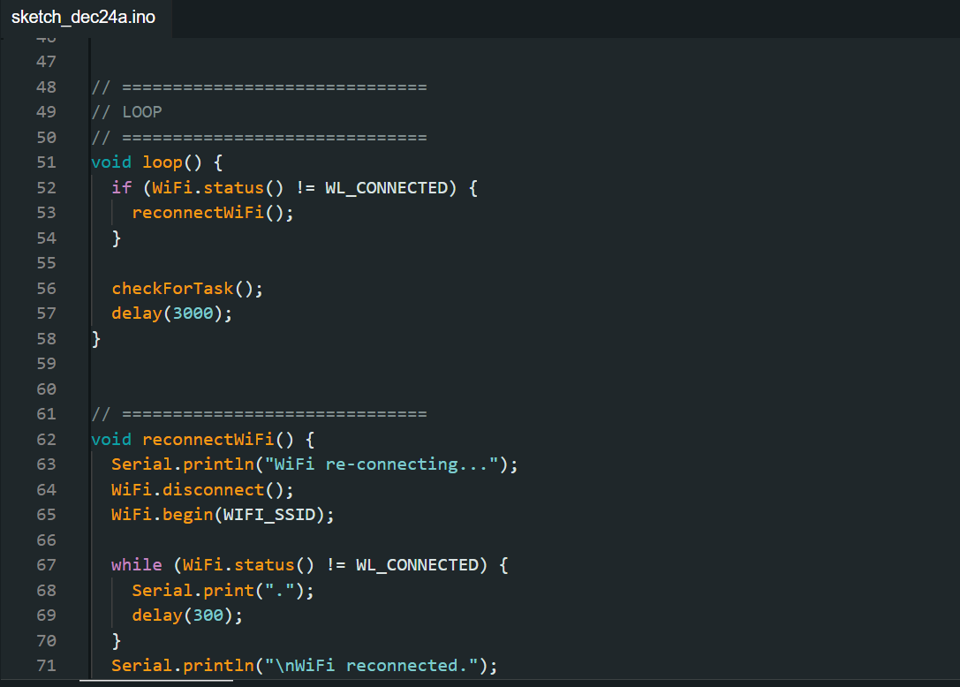
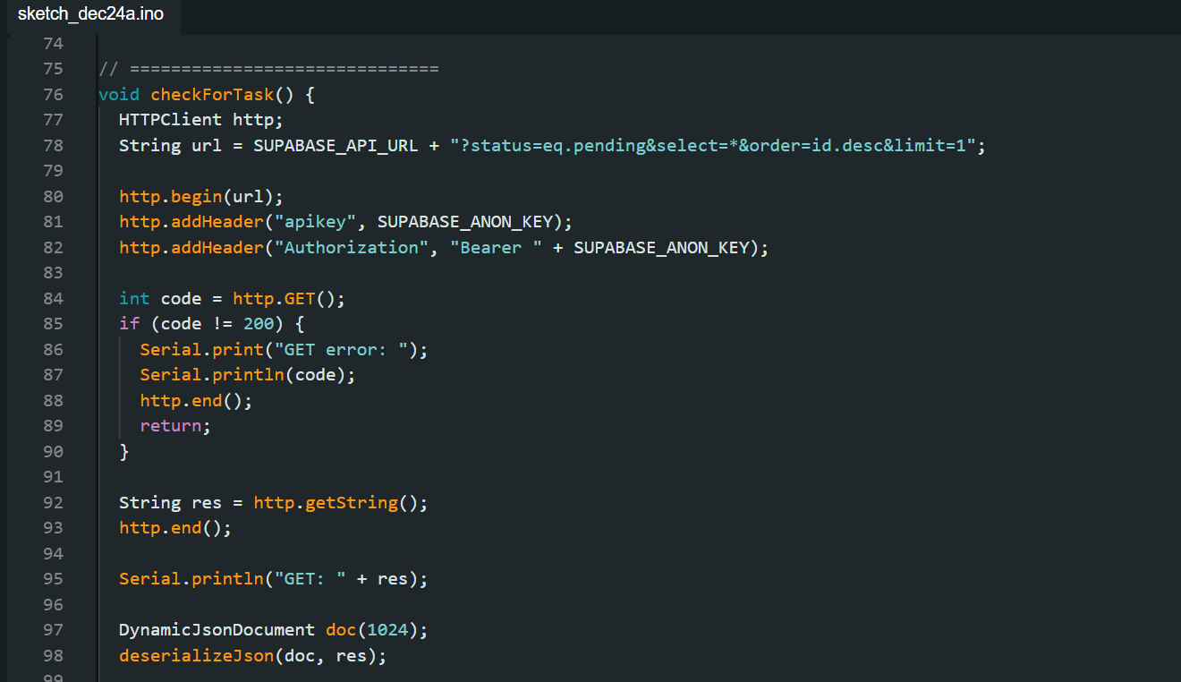
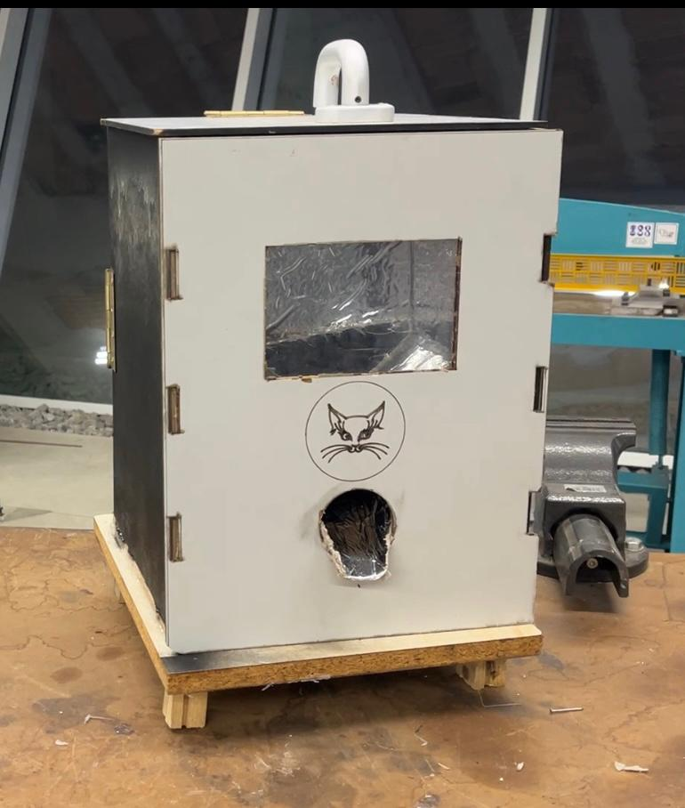
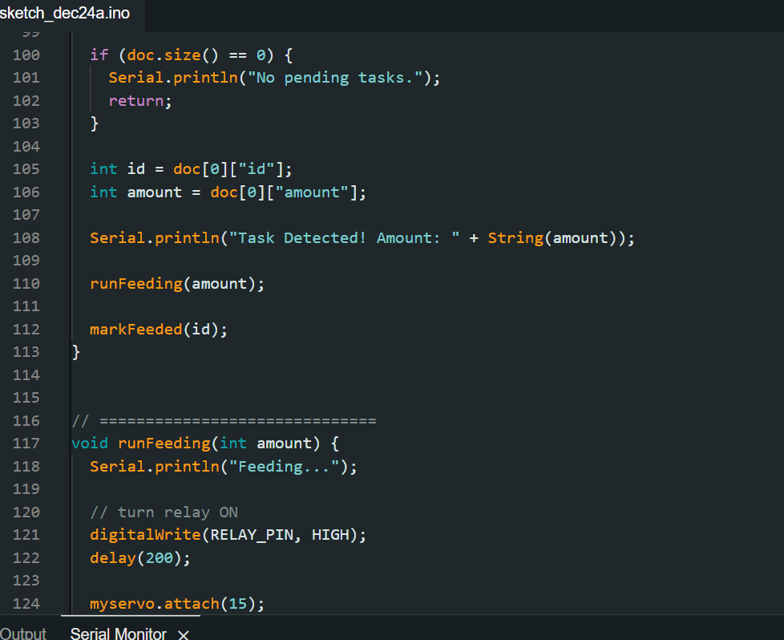
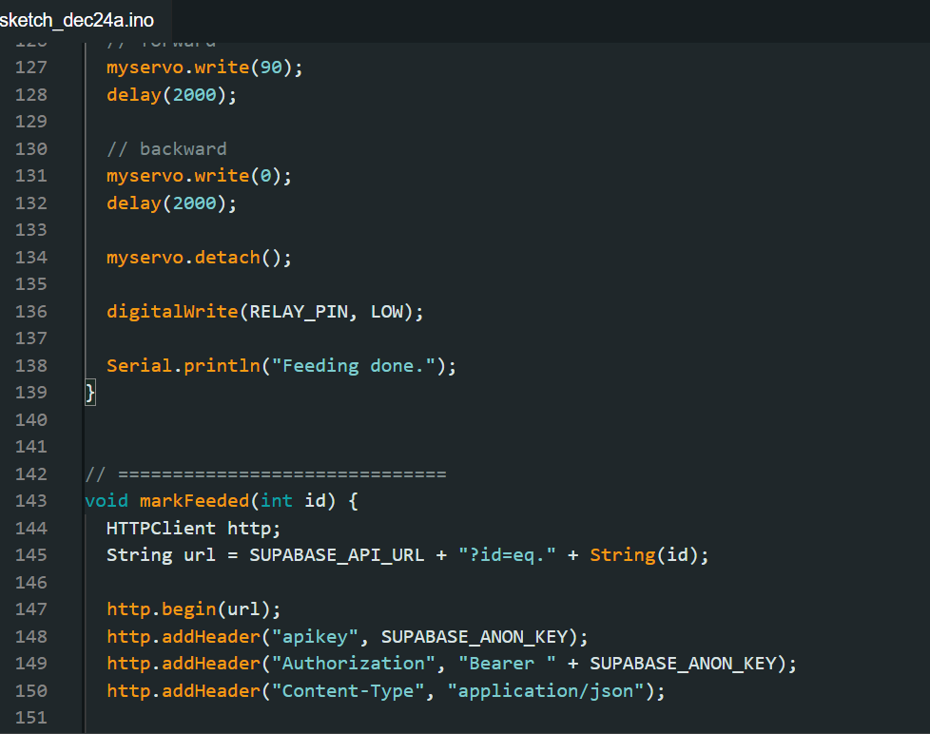
SUSTAINABLE CAPSTONE PROJECTS ( SCAP )
FALL 2025-2026
PET FEEDING SYSTEM
GROUP MEMBERS
INTRODUCTION
FINAL PRODUCT
RESULTS AND DISCUSSION
HANA SHAIMI
22312235 CMPE ENG
MAJDOLINE ELBENNADI 22310812 CMPE ENG
IMANE ELATMANI
22307643 SWEN ENG
WALID TOUIJIR
22307338 CMPE ENG
ADAM ELBOUDALI ZAHID
22316739 SWEN ENG
The Automatic Pet Feeding System is designed to dispense food for pet cats or dogs at predefined times without requiring the owner’s physical presence. The system integrates a feeding mechanism with a control unit to ensure that pets receive a consistent and accurate amount of food in a safe and reliable manner. By automating the feeding process, the system enhances daily pet care and ensures regular meal schedules.
This project addresses common challenges faced by pet owners, particularly those with busy lifestyles or frequent travel commitments, who may struggle to maintain a consistent feeding routine. Irregular feeding can negatively impact a pet’s health, increase stress levels, and lead to issues such as overeating or missed meals. The Automatic Pet Feeding System helps eliminate these problems by providing precise, scheduled feeding with minimal human intervention.
The primary objective of this project is to develop a dependable and user-friendly system that dispenses controlled portions at specific times. In addition to improving convenience for pet owners, the project demonstrates the practical application of automation and embedded systems concepts in solving real-world problems related to pet care.
In this project, an electronic feeding system and an interactive website were developed to create a smart automatic cat feeder. The hardware system was based on an ESP microcontroller, which controlled a servo motor responsible for opening and closing the food outlet. All components were connected through the ESP’s GPIO pins and powered by a battery, allowing reliable and independent operation.
A web interface was also created using HTML, CSS, and JavaScript to monitor the system and manage feeding schedules. Supabase was used as the cloud backend to store feeding data and system logs, enabling real-time updates and remote control. The integration of hardware and software resulted in a modern, user-friendly smart feeding system.
The Automatic Pet Feeding System operated successfully by dispensing food at the correct times and ensuring a smooth feeding process. The recycled wooden structure and plastic bottle effectively guided the food without blockage, while the electronic components (ESP microcontroller, servo motor, and battery) functioned reliably. The website connected to the Supabase database also performed well, enabling real-time data storage and monitoring.
Although the system met its main objectives, future improvements could include adding sensors (such as weight or motion sensors), AI camera integration, enhanced portion control, a more durable casing, and additional website features like notifications or mobile app support. Overall, the project achieved its goals and shows strong potential for further development.
MATERIALS USED IN CONSTRUCTION
CONCLUSIONS
For this project, both recycled and new materials were used to build the Automatic Cat Feeding System, focusing on sustainability and functionality. Recycled materials included a wooden base and box, which formed the main enclosure, and a plastic bottle placed inside the box to guide food smoothly into the bowl and prevent blockage. This approach reduced cost and waste while demonstrating the reuse of household materials in engineering applications.
The electronic components consisted of an ESP board as the main controller, a servo motor to control food portions, connecting wires, and a battery for power supply. Together, these components enabled automatic, precise, and reliable feeding for pets.
In conclusion, this project successfully demonstrated the design of a reliable automatic pet feeding system using simple electronics and recycled materials. The ESP microcontroller, servo motor, and battery worked together to dispense food accurately, while the reused wooden box and plastic bottle provided a practical and sustainable structure. The integrated website connected to a Supabase database added real-time monitoring and control capabilities.
Despite challenges such as limited budget, component availability, and restricted resources in Cyprus, the project encouraged creative problem-solving and hands-on learning. Through the SCAP program, valuable experience was gained in embedded systems, teamwork, and adapting to real-world engineering constraints.
Figure 1. WEBSITE QR
Figure 3. ESP32 AND SERVO MOTOR CIRCUIT
Figure 2.WEBSITE INTERFACE
REFERENCES
Espressif Systems, “ESP32/ESP8266 Technical Reference ManuaL
Arduino, “Arduino IDE User Guide.”
Tower Pro, “SG90 Micro Servo Motor Datasheet.”
Songle, “SRD-05VDC-SL-C Relay Module Datasheet.”
Supabase, “Supabase Documentation.”
Mozilla Developer Network (MDN), “HTML, CSS, and JavaScript Web Documentation.”
SparkFun Electronics, “Basic Electronics and Microcontroller Tutorials.”
Figure 3. ESP 32CODE USING ARDUINO IDE SOFTWARE
Figure4. The final Product

